Slide 1

Title: Career Trends Explorer and Personalized Job Matcher
Subtitle: Empowering job seekers with actionable insights Name: Sapna Kharche

Slide 2

Project Overview
The platform provides an in-depth analysis of workforce trends and personalized job recommendations.
It leverages historical and real-time data to empower job seekers and recruiters with actionable market insights.

Slide 3
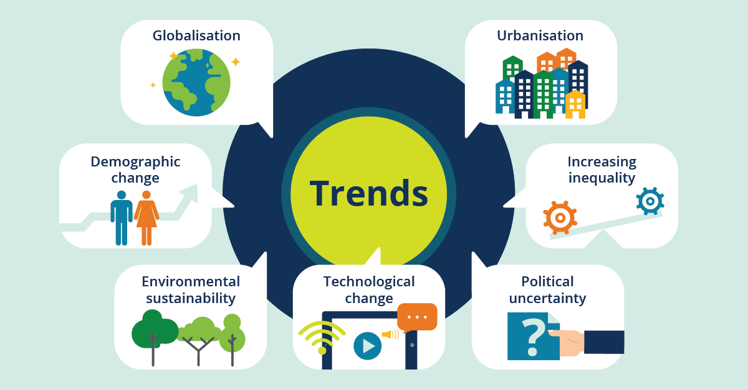
Problem Statement
The job market is constantly changing due to technological advancements, economic shifts, and evolving work preferences. There is a need for tools that help users navigate these complexities effectively.

Slide 4
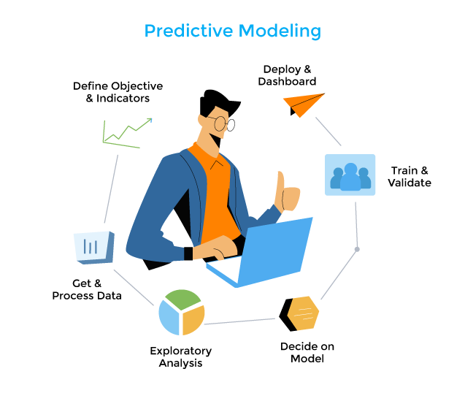
Solution
A comprehensive job matcher that utilizes advanced data analytics and predictive modeling.
It delivers insights into high-demand roles, salary patterns, and personalized job opportunities tailored to user preferences.

Slide 5
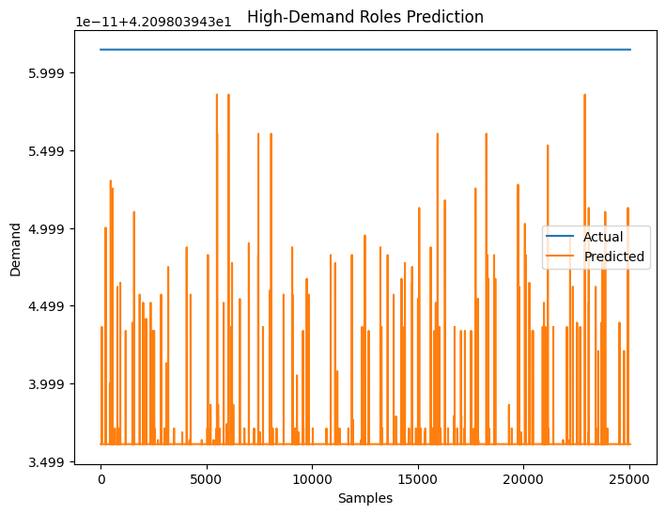
Methodology
The project involves analysing job postings and salary data, building predictive models for real-time insights.

Slide 6
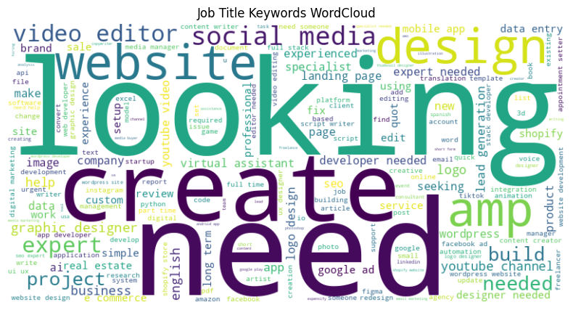
Key Features
Key features include trend analysis, regional salary comparisons, demand forecasting, and an interactive dashboard. Users receive tailored job recommendations based on their skills and preferences.

Slide 7

Results and Achievements
The platform successfully identified emerging job categories and high-demand roles.
It provided actionable insights, helping job seekers and recruiters make data-driven decisions effectively.

Slide 8

Challenges Faced
Major challenges included managing large, diverse datasets and adapting to the dynamic nature of the job market.
Balancing technical implementation with market needs was critical.

Slide 9

Conclusion
The platform bridges the gap between job market opportunities and career goals.
It enables users to make informed decisions and aligns recruiters’ strategies with market trends effectively.

